Slide 1

Descriptive Analysis

Slide 2
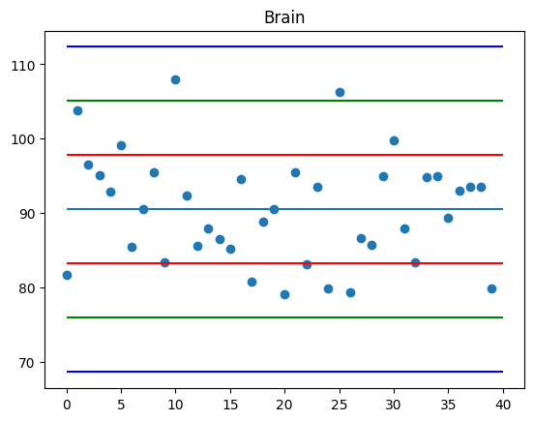
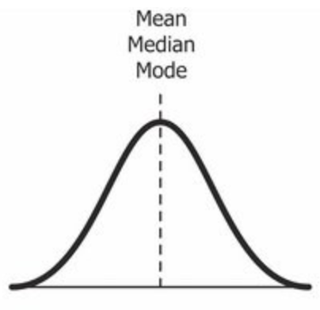
Standard deviation of Brain
Mean = 90.48, median = 90.54 and mode = 79.86, 93.55
Based on the central tendencies the data is Normally Distribution.
The region of two standard deviations is where the maximum datapoints are located. That’s why the variable is a bimodal data.

Slide 3
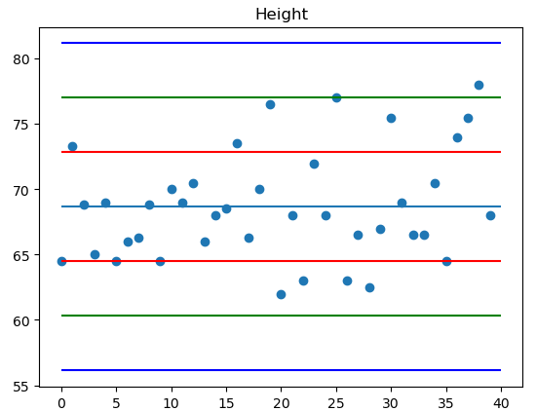
Standard deviation of Height
Mean = 68.65, Median = 68.00 and Mode = 64.5, 68
Based on the central tendencies the data is Normally Distribution.
This variable is bimodal, as the data is spread into two standard deviations. However, more data is spread in one standard deviation, but there is a considerable amount of data spread in other that’s why it’s a bimodal distribution.

Slide 4
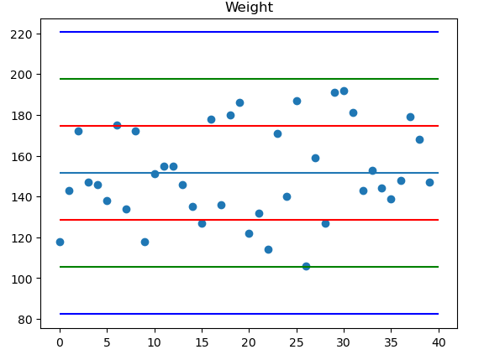
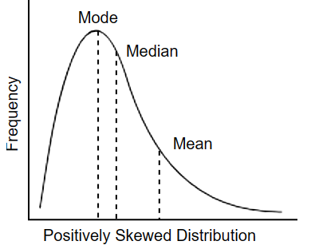
Standard deviation of Weight
Mean = 151.38, Median = 147.00 and Mode = 118, 127, 143, 146, 147, 155, 172
Since mean is greater than median it is Positively skewed distribution.
Since the Data is spread across the graph because of high standard deviation it’s a multimodal data.

Slide 5
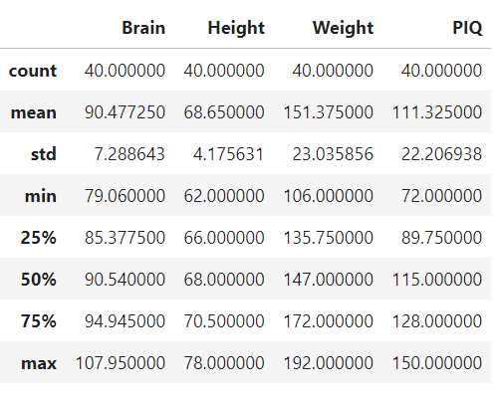
Key Variables
The describe() method in Python produced the Data seen above Based on the IQAnalysis file. It was displayed in graphs, and the mean was used to determine its nature. As can be seen above, there is a significant difference in the mean and standard deviation of the weight when compared to the other two variables.
The 3 insights are:
Height has the lowest standard deviation and mean, indicating that it has the least impact on PIQ.
Weight has the highest standard and mean, demonstrating that the data is more dispersed and has a greater impact on PIQ.
There is a correlation between height and weight Based on the above graphs and numbers.

